Slide 1


Azure Dev Day
Notes:
Welcome to Azure Dev Day

Slide 2




Joel Waymack
Cloud Solution Architect
Azure Dev Day
joel.waymack@microsoft.com
www.linkedin.com/in/joel-waymack
https://github.com/joelwaymack
Notes:
Introduce yourself

Slide 3

Marcus Milhomem
Solution Sales Professional – Azure App Innovation
Azure Dev Day
marcus.milhomem@microsoft.com
www.linkedin.com/in/mmilhomem
https://github.com/mmilhomem
Notes:
Introduce yourself

Slide 4
Devs
Notes:
Today is all about YOU – developers
Even if you’re not a dev today should be helpful for you
3 target groups
Never used Azure – gain basic concepts
Familiar with Azure – understand common architectural patterns
Very knowledgeable – pick up some interesting nuggets

Slide 5




Agenda (CDT)
8:30 | Intro and fundamentals
8:45 | Web-based solutions
10:15 | Serverless, event-driven solutions
11:30 | Lunch (+ Power Apps bonus)
12:15 | Microservice solutions
2:00 | DevOps for deploying solutions
3:30 | Closing thoughts
Notes:
4 content sections today
Each section has
An overview of the solution area
A hands-on lab
Lab is subset of solution area
We’ll also have
Breaks (including lunch)
Lots of FUN!
End around 3:30 Central today

Slide 6
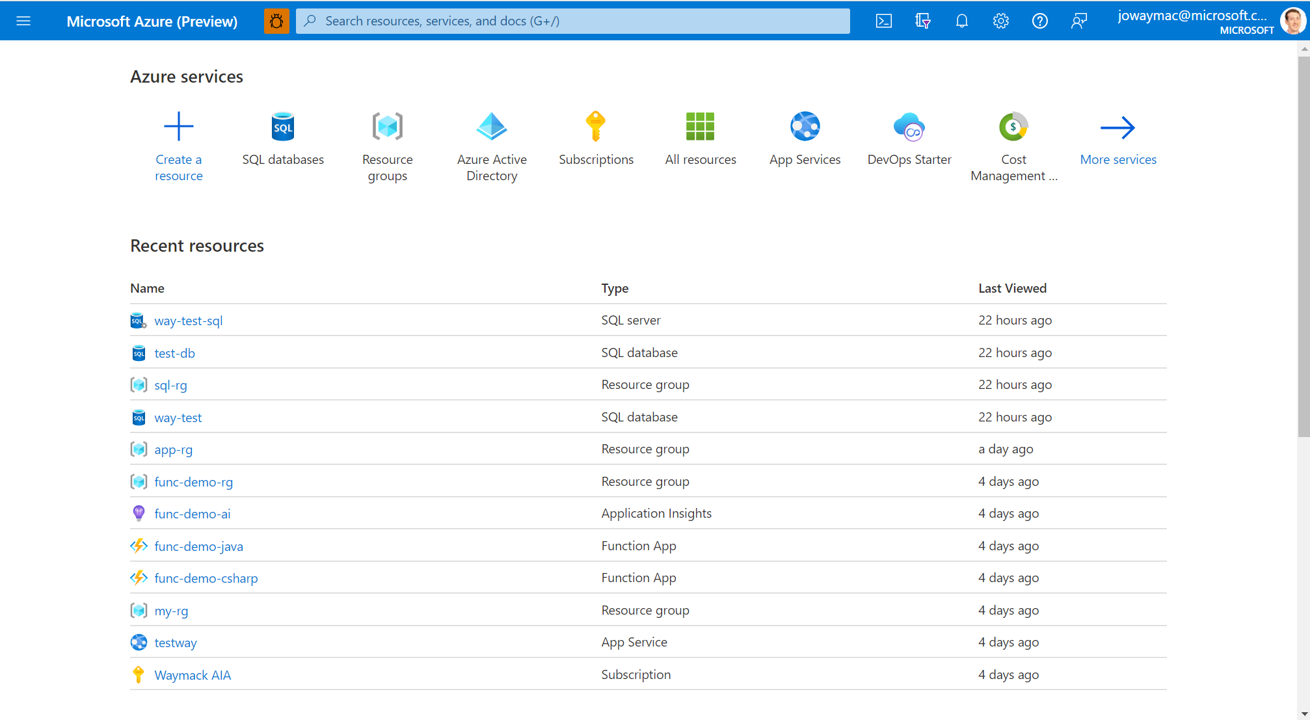

Slide 7



Resource Management
Azure Active Directory Tenant
Azure Subscriptions
Azure Resource Groups
Notes:
Azure Active Directory is the identity provider for provisioning Azure resources
Includes login identities
Includes application/resource identities (service principals)
Source for Role-based-access-control (Identity and Access Management)
Azure subscriptions
Roll-up billing bucket for all Azure provisioned resources

Slide 8
Azure Active Directory
Single organizational Tenant
Management of
Users
Applications
Groups
Role based access control (RBAC)
Owner – Manage everything including RBAC
Contributor – Manage everything except RBAC
Reader – View everything
Notes:
Often called IAM (Identity and Access Management) or RBAC (Roll based access control)
Every resource, resource group, and subscription can have RBAC permissions set on it
The identities or groups you assign RBAC permissions to are tied to the AAD tenant that the subscription is tied to
Use the built-in roles unless you have specific needs

Slide 9
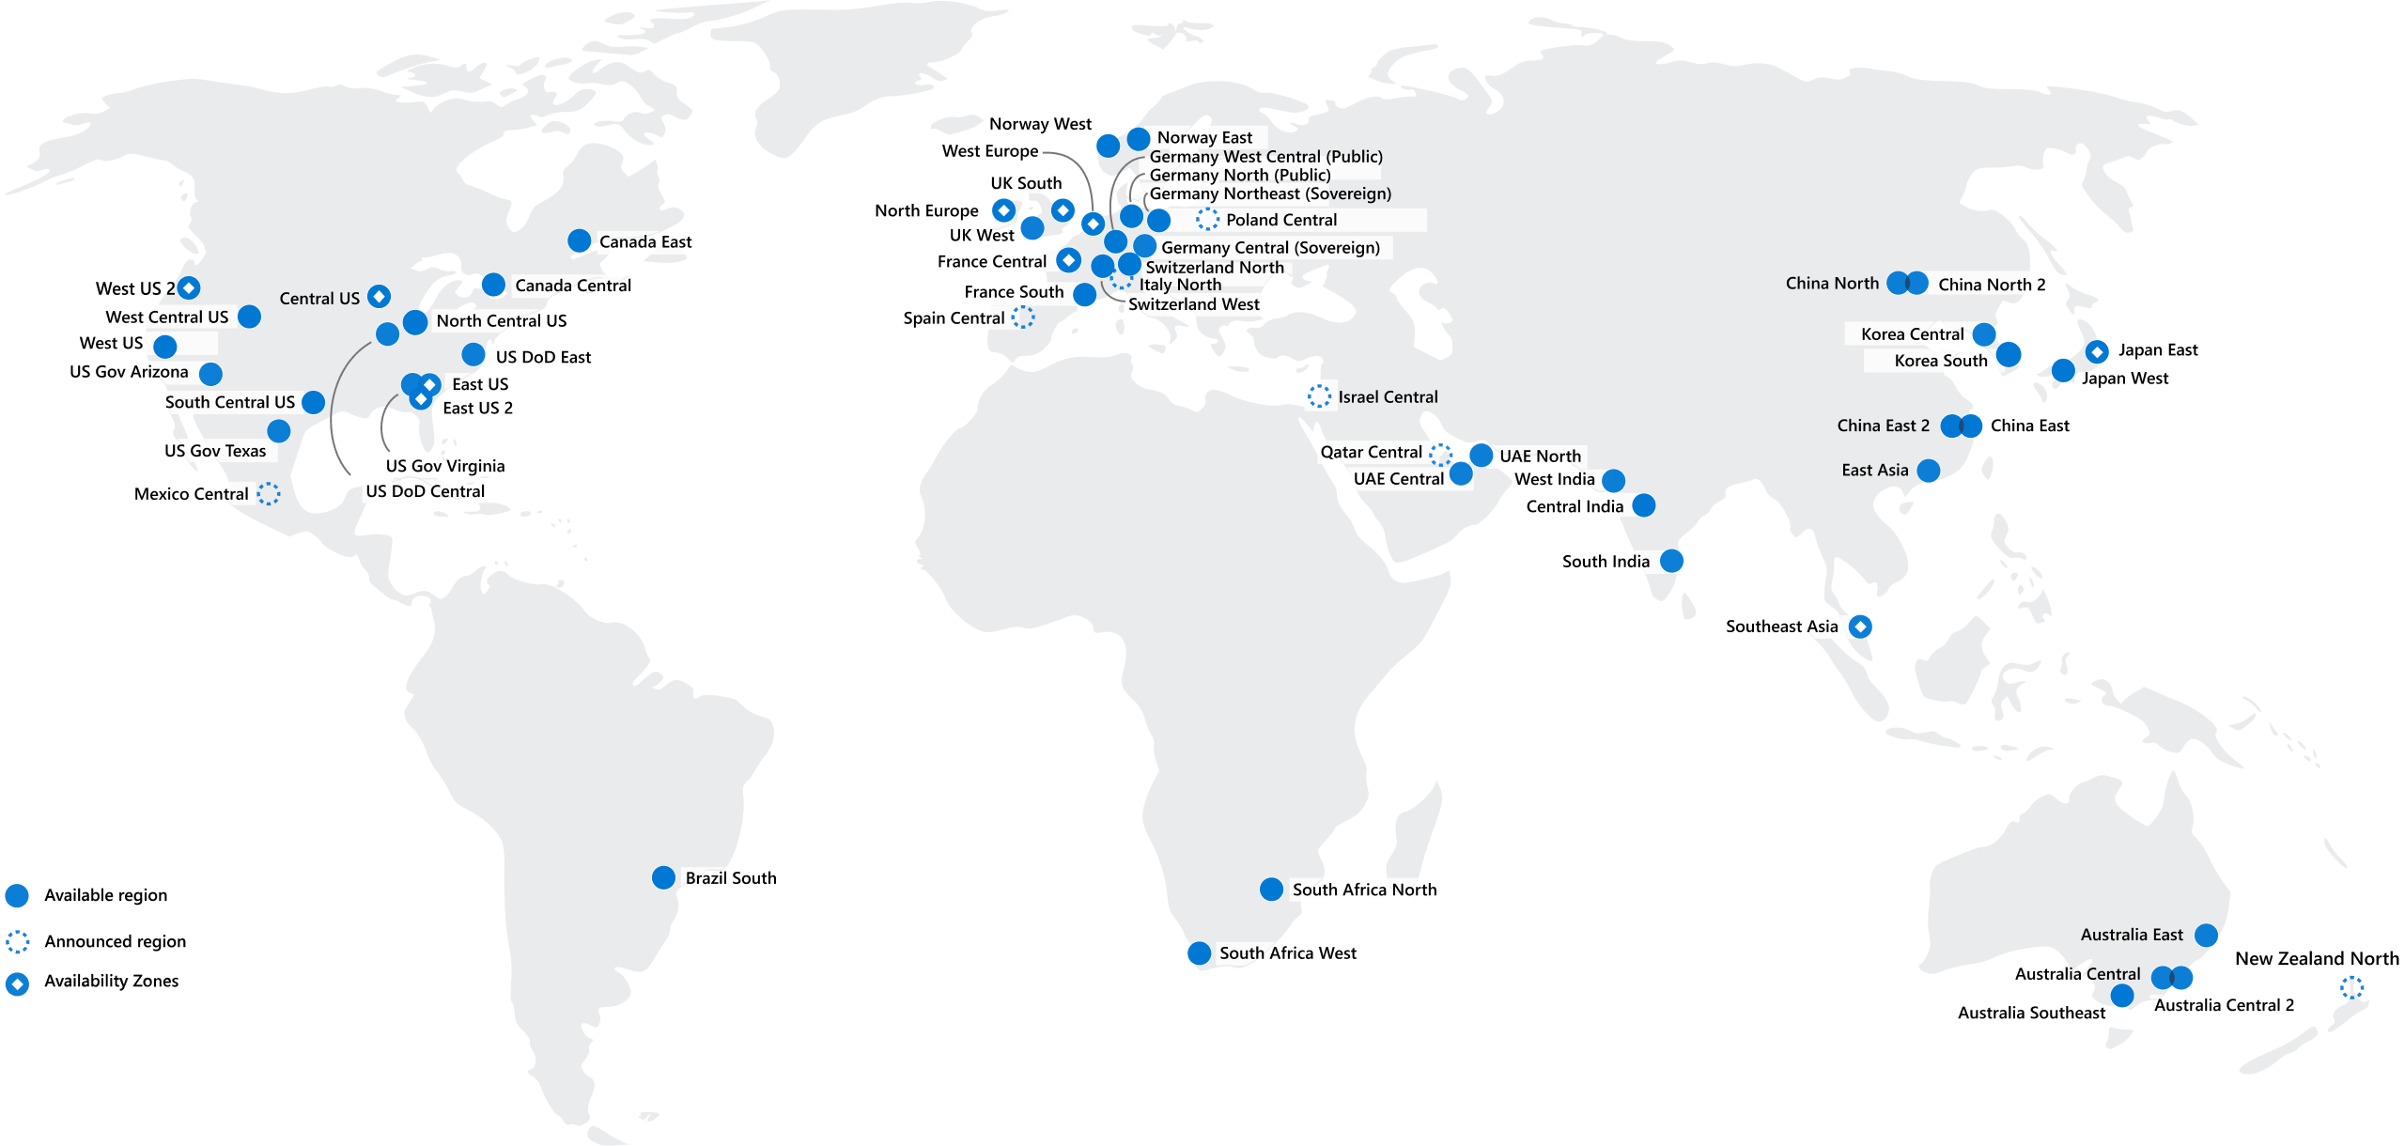
Regions
Notes:
Each region is a set of datacenters
Each datacenter has a very-low latency requirement in a region
New regions going in all the time
Consider which region is closest to your users

Slide 10
Prerequisites
Azure subscription
https://azure.com/free
GitHub Account
https://github.com/signup
Notes:
You’ll need an Azure subscription
A company provided subscription might be locked down for some of the services
You also likely won’t be able to provision app registrations in Azure Active Directory for the DevOps portion
You can create a free subscription
Note: You will have to enter credit card info but you won’t be charged

Slide 11
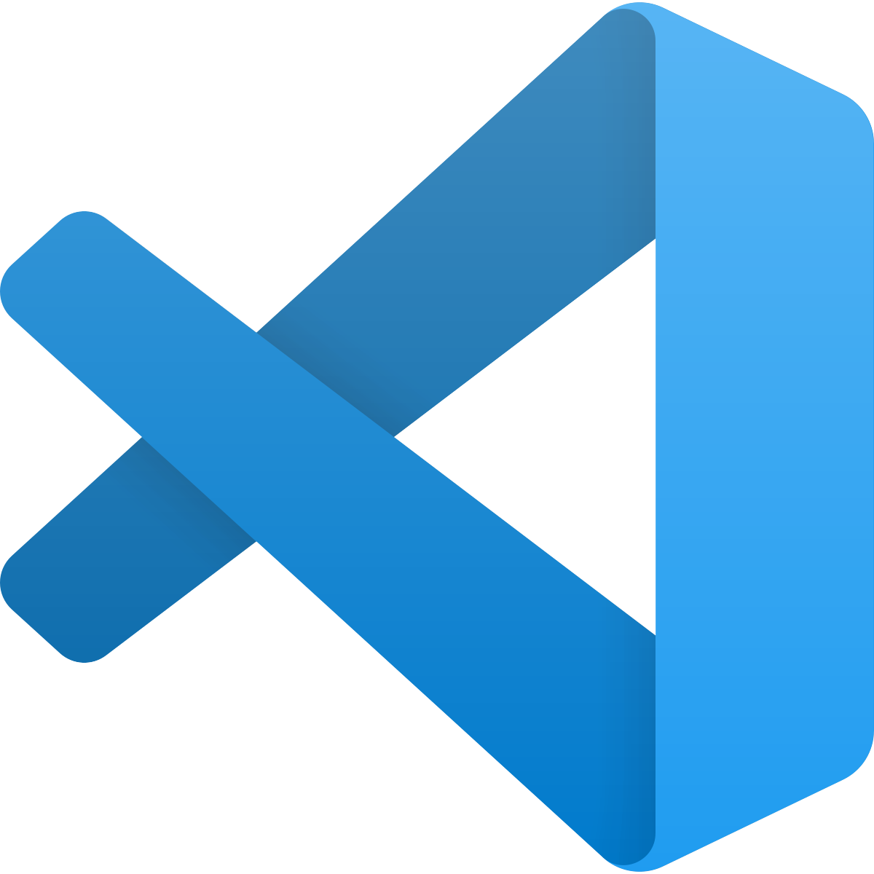
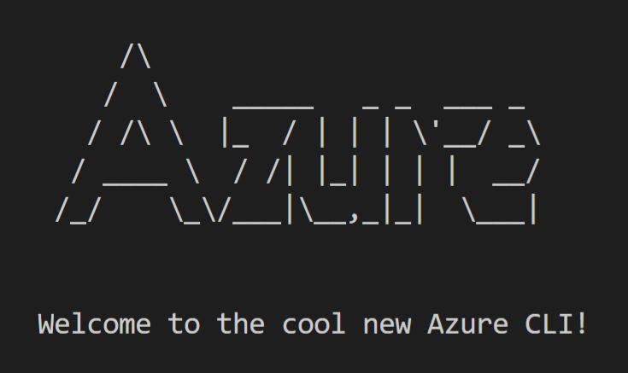

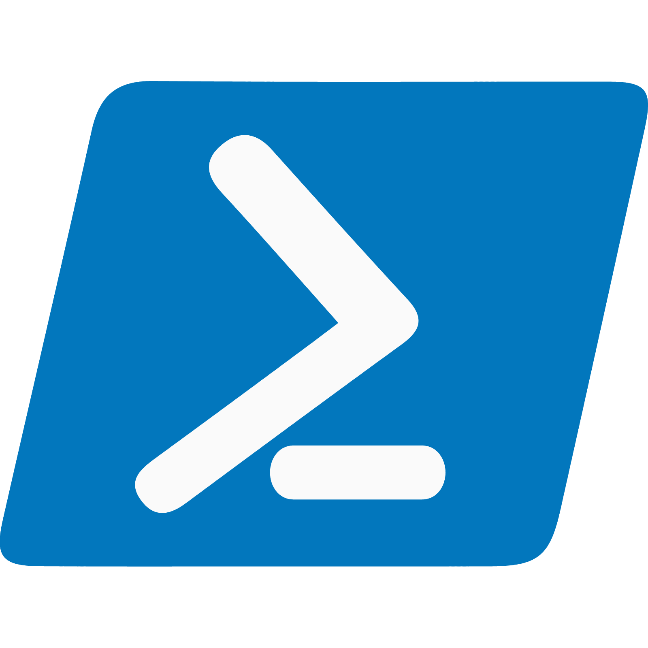
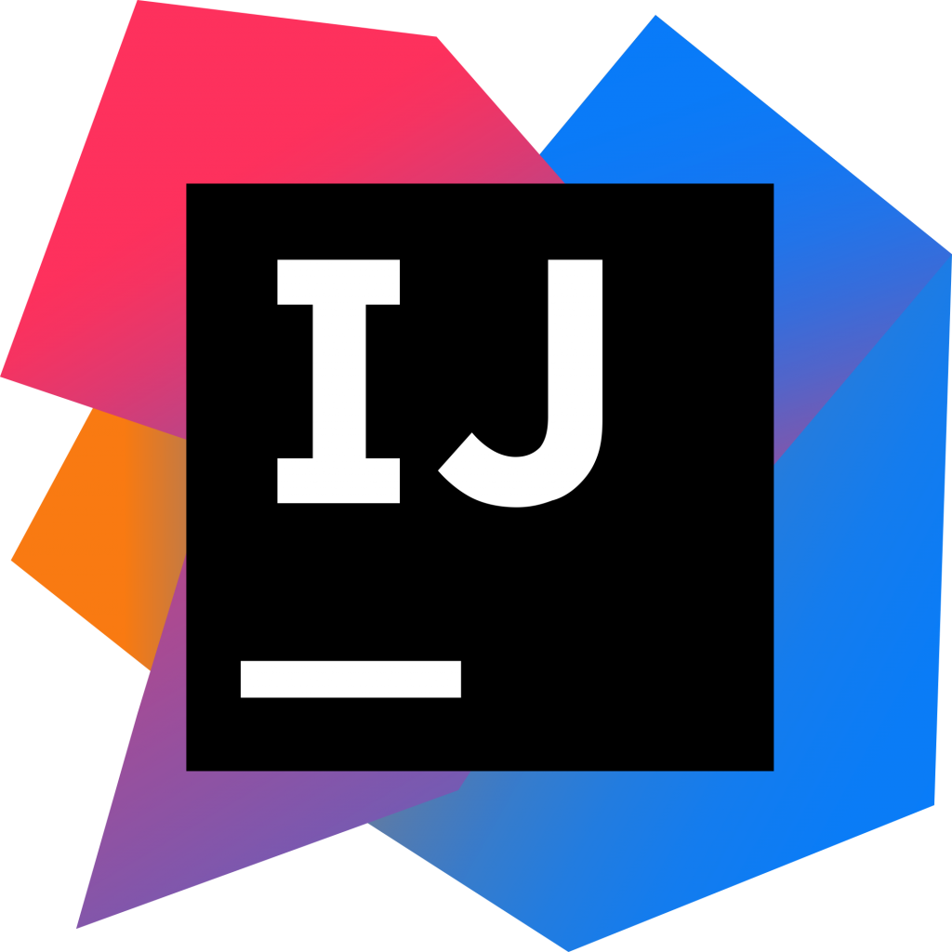
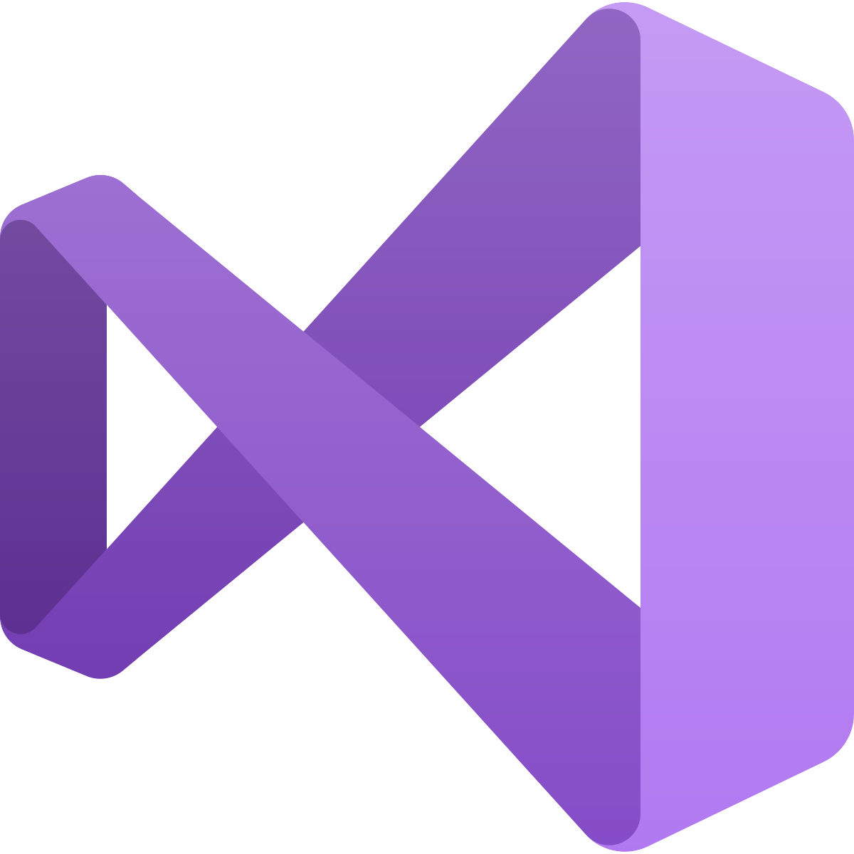
Sample of available tools
+ Azure Tools Extension
+ Azure Toolkit Plugin
+ Azure Toolkit
+ Cloud Explorer
Notes:
Lots of tools for use with Azure
These tools use the Azure Resource Manager REST API

Slide 12
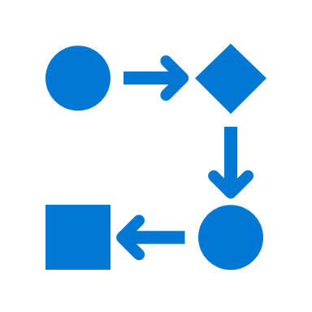

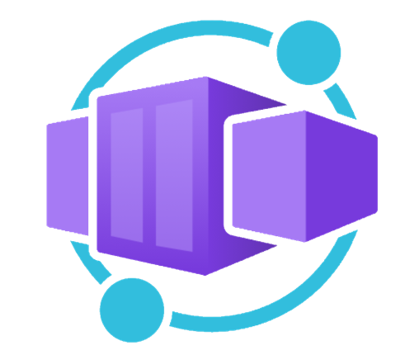


Application hosting continuum
IaaS
Infrastructure Platform
CaaS
Container Orchestration
Platform
PaaS
Application Platform
FaaS
Serverless Platform
Low Code
App and Orchestration
Platform
Virtual Machines
Azure Kubernetes
Service
Azure Container Apps
Azure Spring Apps
Azure App
Service
Azure Functions
Azure Logic
Apps
Power Apps
More Control of execution environment
Less Control of execution environment
Less Agile development & deployment
More Agile development & deployment

Slide 13
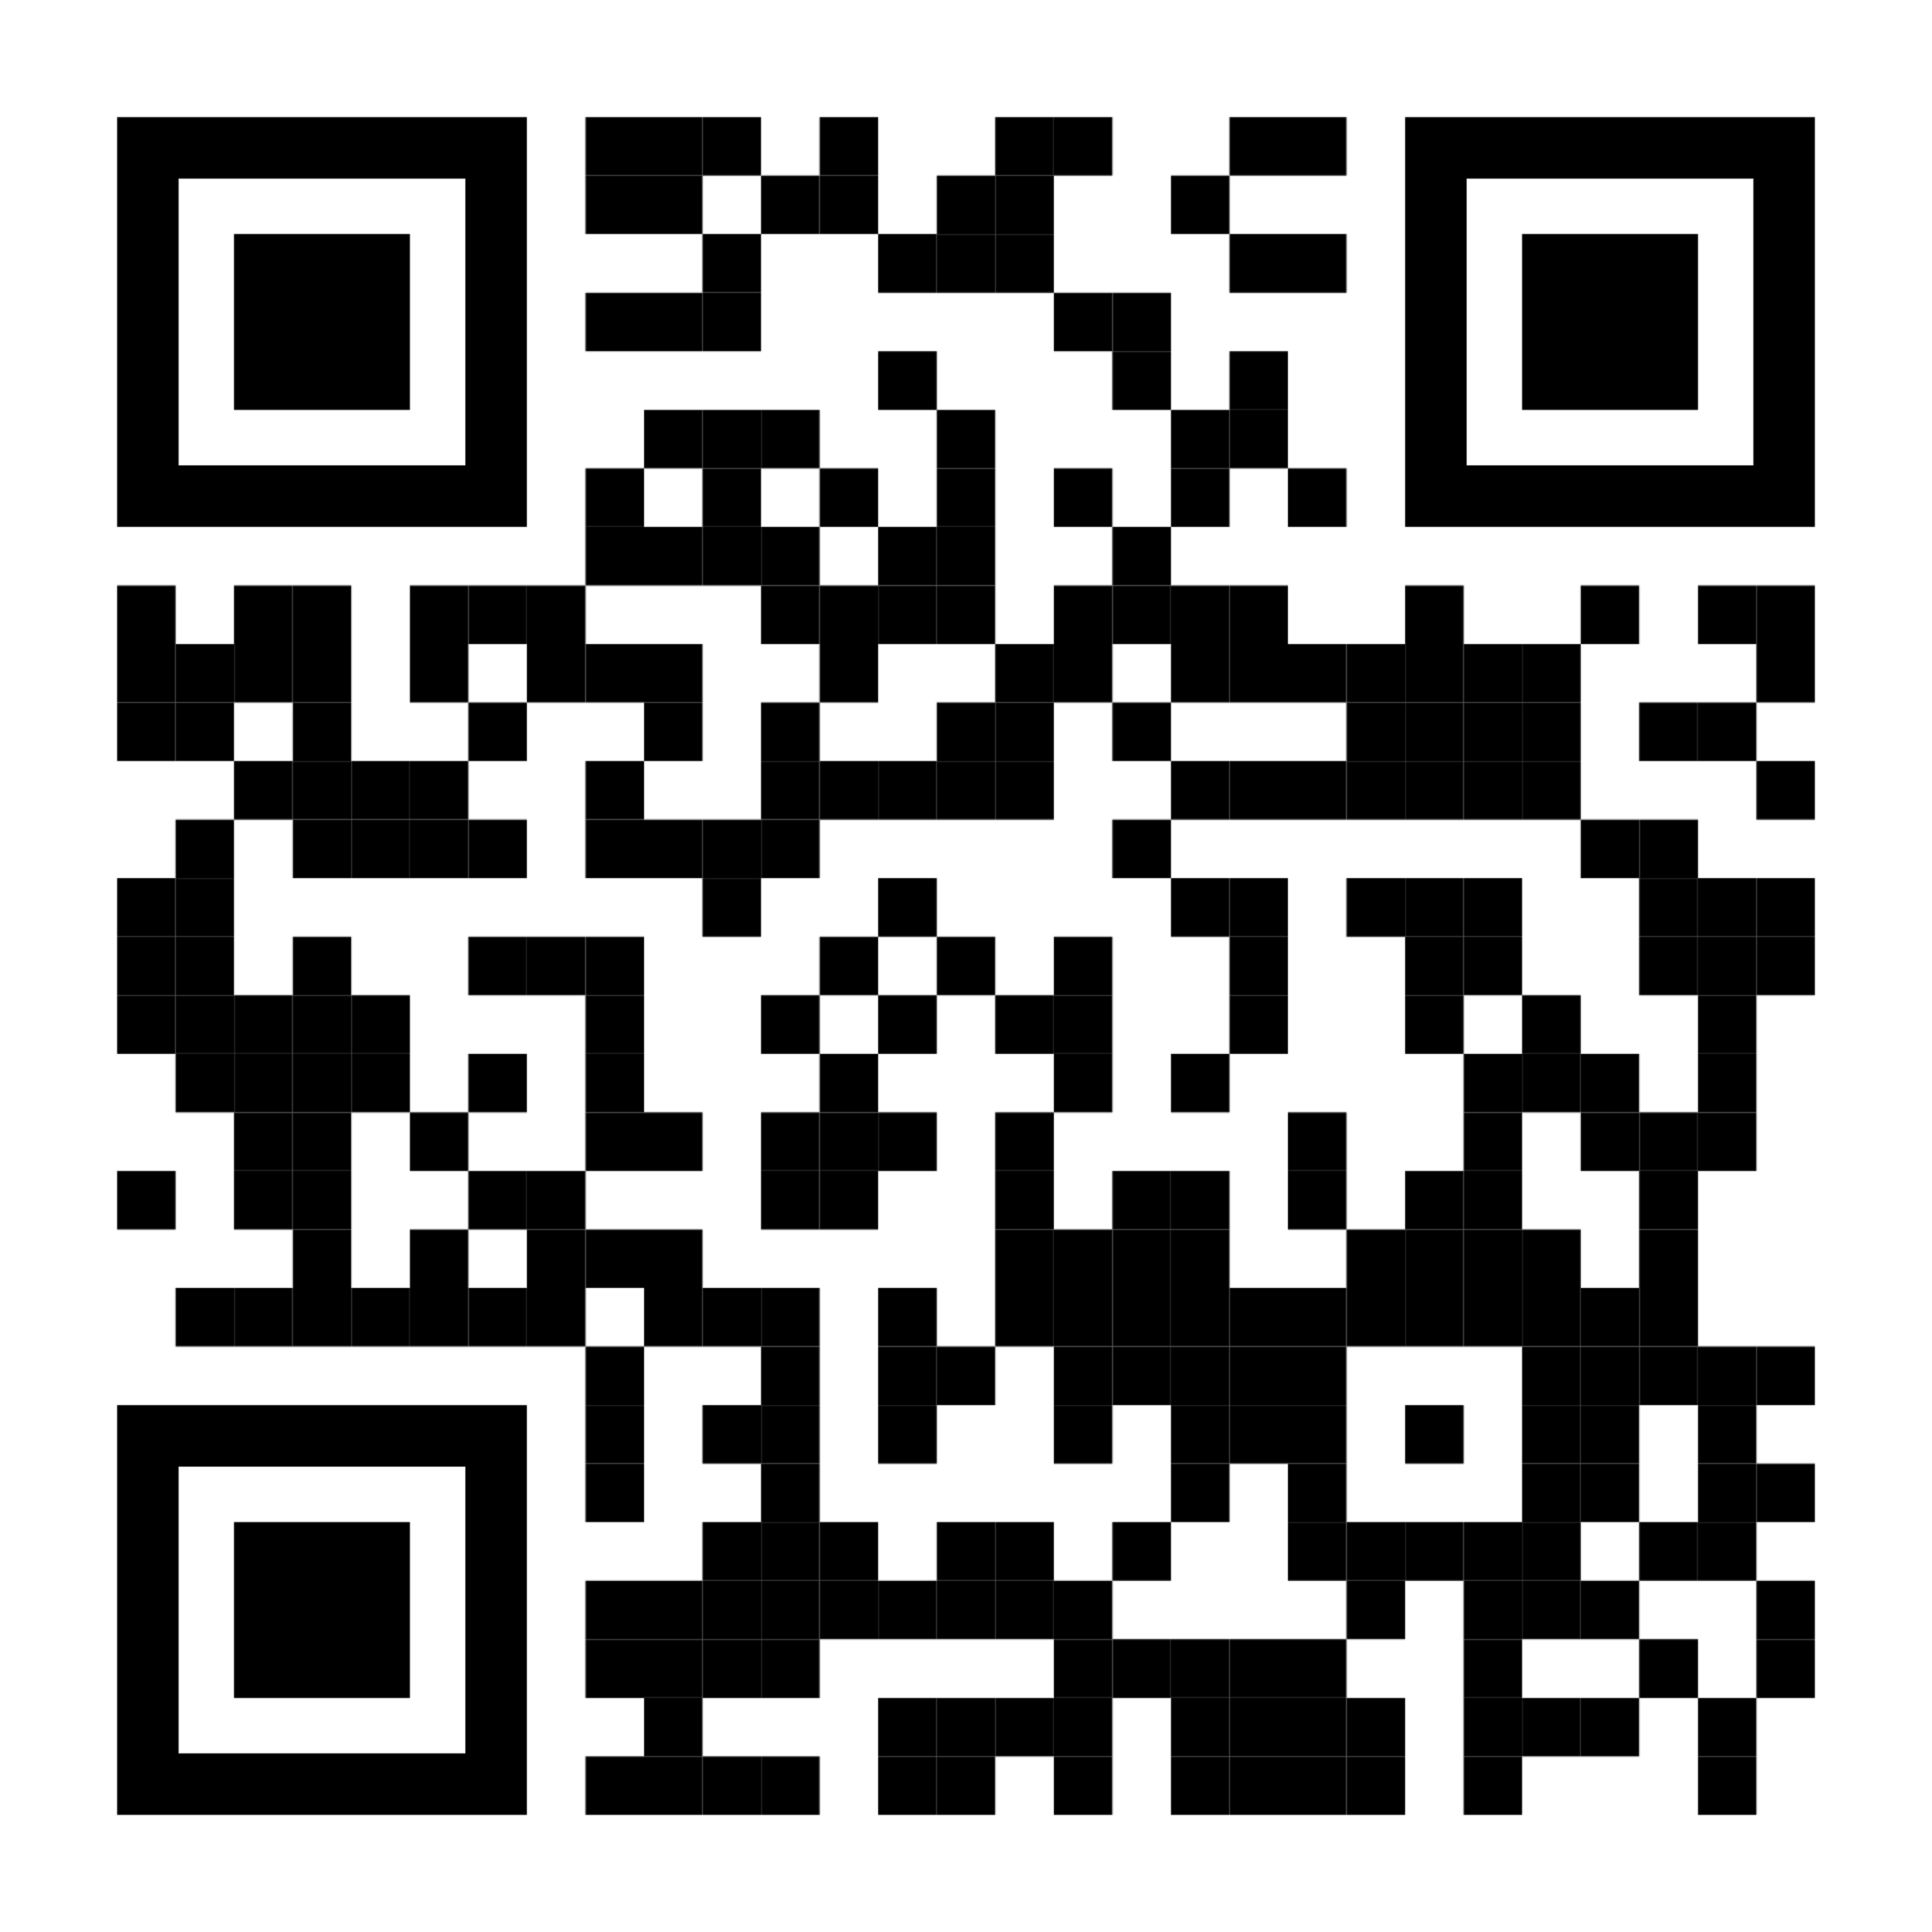

Sign up for Microsoft.Source
Thank you!
Receive a regular digest of relevant technical content, events and training
Get the best of the newest resources, tools and guidance to help developers quickly build and deploy on Azure
Please fill out the Azure Dev Day Survey!
aka.ms/azuredevdaysurvey
And visit our event content page to access lab materials, presentations and more about the Microsoft Build Conference!
aka.ms/azuredevdaycontent
Get the latest articles, documentation, and events from Microsoft.Source—the curated monthly developer community newsletter.
Stay at the forefront of rapidly evolving technologies with resources that are relevant to your field, location, and areas of interest—including articles, GitHub repositories, and how-to guides.
Get notified about events—from local hacks, workshops, and training sessions to virtual meetups and global conferences.
Learn what you want, when you want, how you want. Resources include in-person hands-on workshops, free, interactive online training and sandbox environments.

